Slide 1
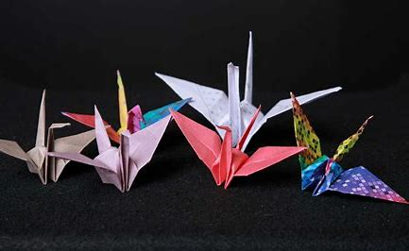
TO OUR WEBSITE PRESNETATION

Slide 2
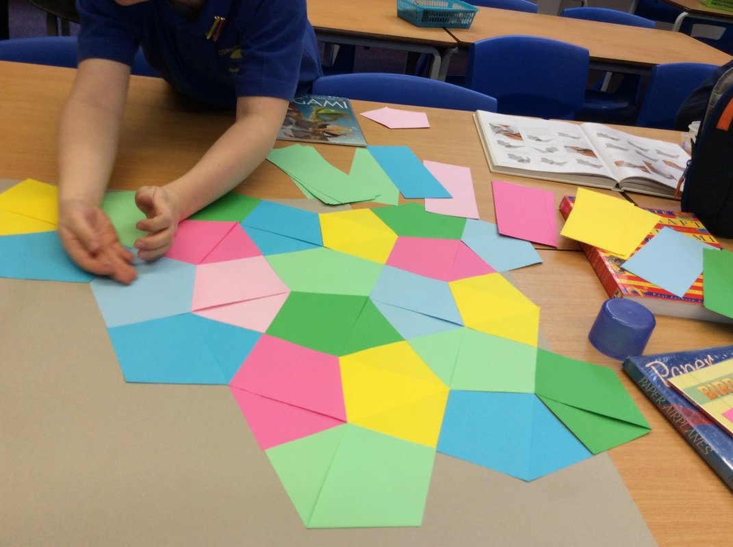
THE
FOLDING
EDGE

Slide 3
OUR TEAM MEMBERS
1 : Abdul Ahad Zubairi
2 : Sana Maqbool Ahmed
LEADER
"This website
has been
Designed
by
Ashhal Afzal ,
the leader
of this team."
3 : Muhammad Raza Sajid
4 : Eman Siddiq
5 : Muhammad Fasih Sarfaraz

Slide 4










Slide 5

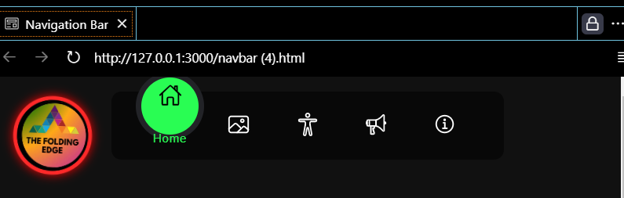
NAVIGATION BAR
Muhammad Raza Sajid ‘’created the website’s Navbar, Includes pages for Home, Gallery, About Us, Contact Us,
Feedback, Kids Categories, and Elders Categories.’’

Slide 6
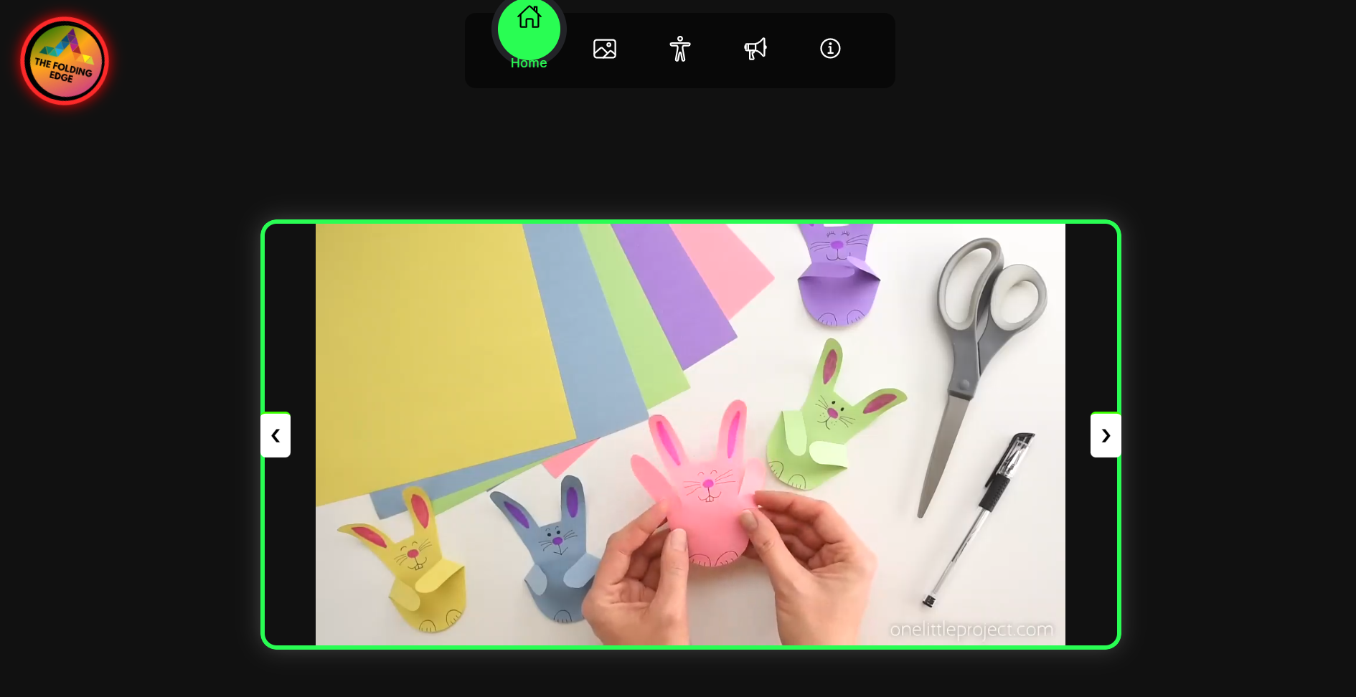
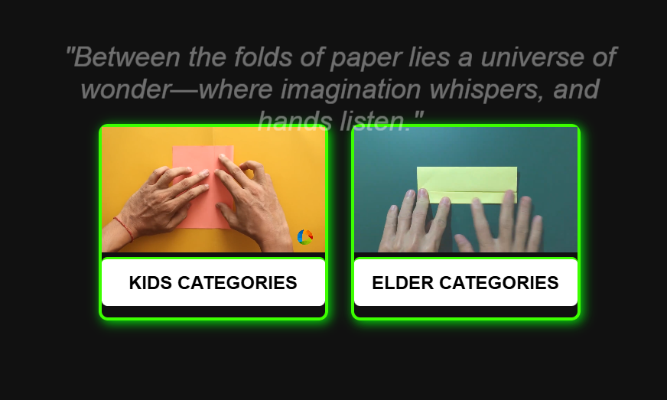
HOME PAGE
Muhammad Raza Sajid created."This homepage
shows carousel with
origami videos that
you can play and pause".
It also displays
inspirational quotes about
origami and has links
for kids' and
elders' categories.

Slide 7
ORIGAMI GALLERY PAGE
This gallery page, created by
Muhammad Fasih Sarfaraz, displays various origami
images categorized into animals, objects,
decorations, flowers
insects, marine life,
clothing, and
fantasy creatures.

Slide 8
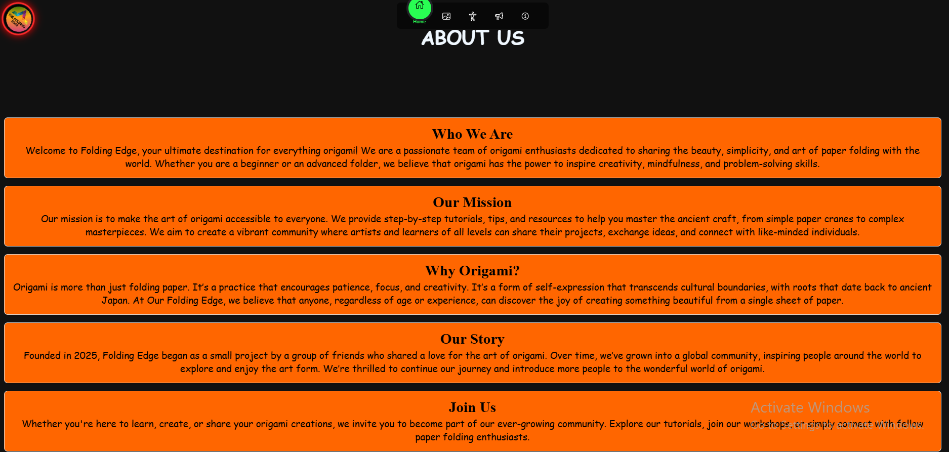
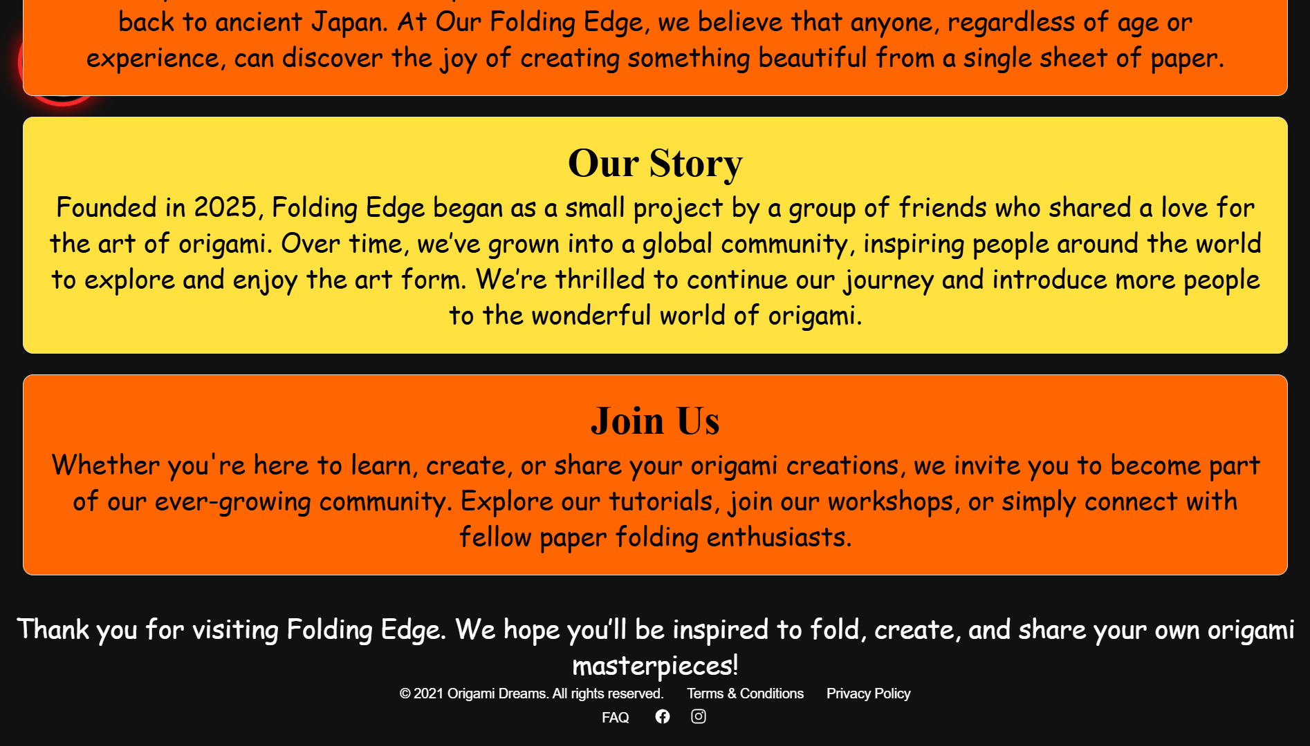
ABOUT US
Abdul Ahad Zubairi has created the "About Us" page for the website, introducing Folding Edge as a global community focused on making origami accessible and connecting enthusiasts through tutorials and creative projects.

Slide 9
CONTACT US
"Eman Siddiq has
designed a Contact Us
page Featuring a form where users can submit
their name, email, query
type, message, and an
optional file attachment,
along with a submit button
to send the information.”

Slide 10
FEEDBACK FORM
Sana Maqbool Ahmed
has created a feedback
Page where users can
Submit their Name, Email, Rating, Feedback, Suggestion
And an optional file .After
Filling out the form, users
Can submit their input to
the server via the
‘’Submit-feedback’’
endpoint.

Slide 11
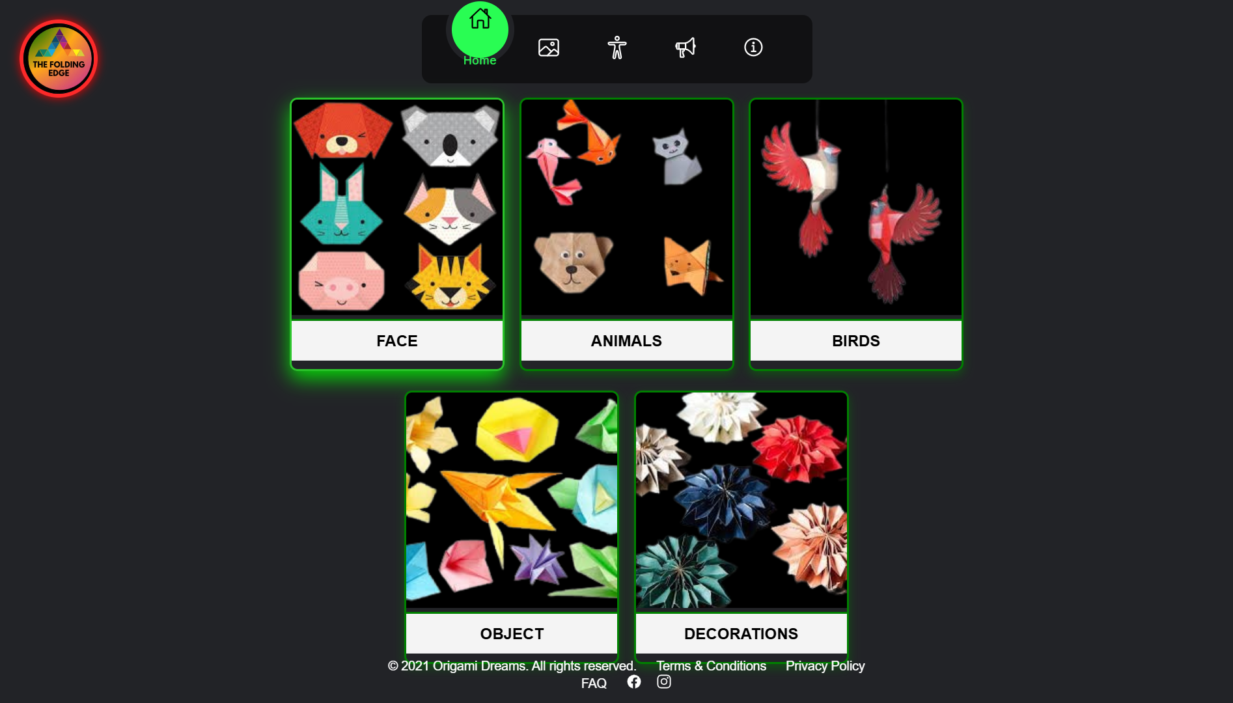
KID CATEGORIES
This website features a kids' categories page with image links for various sections such as faces, animals, birds, objects, and decorations, and includes a footer with legal and social media links

Slide 12
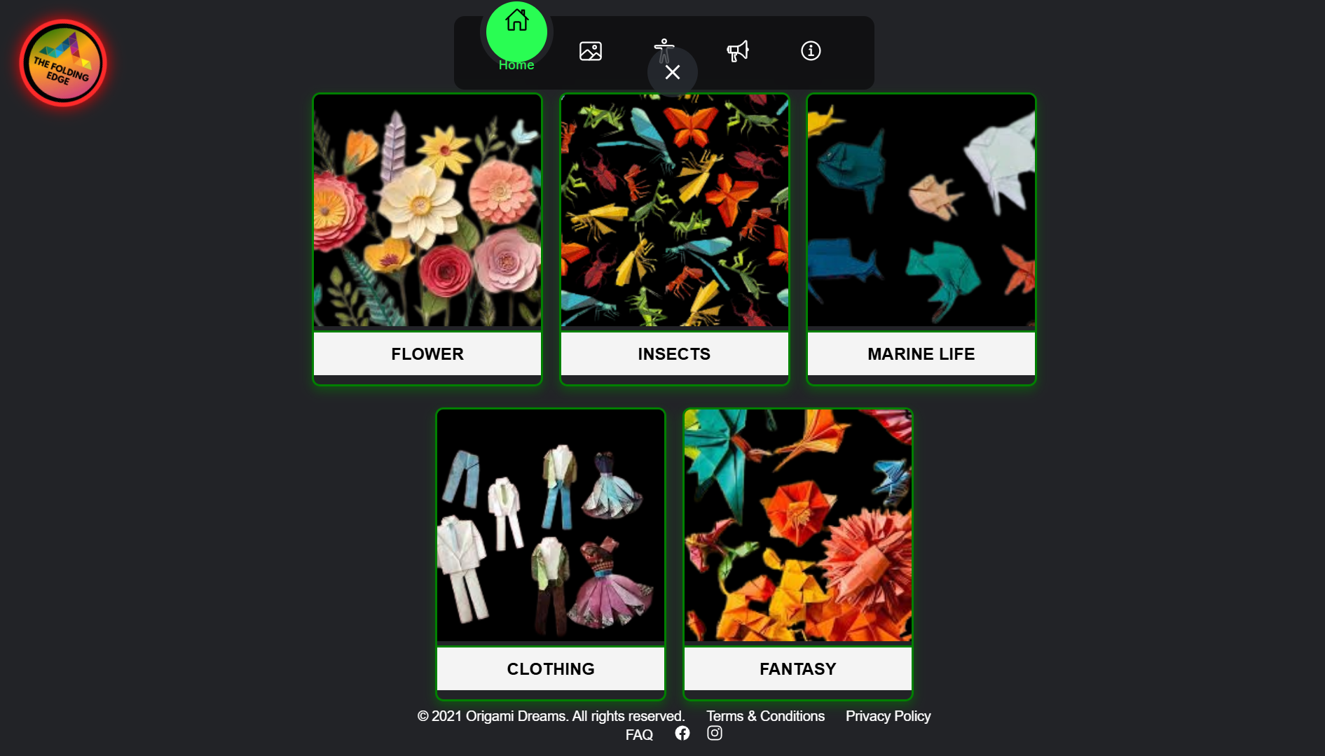
ELDER CATEGORIES
This code creates a page with categories
for Elders, featuring sections with images and links for Flower, Insects, Marine Life, Clothing, and Fantasy.

Slide 13

The Folding Edge
website is a collaborative effort by the entire team, offering sections such as Home, Gallery, About Us, Contact Us, and Feedback. It includes dedicated categories for Kids and Elders, providing an engaging and
informative platform

Slide 14

FOOTER
"Muhammad Raza Sajid created the website’s
footer, which includes.
''This footer contains
copyright information,
links to the Terms and
Conditions, Privacy Policy, FAQ, and social media icons
for Facebook Instagram.

Slide 15
THANK
YOU

